Slide 1
MLOps: Practices and Platforms (Open Source, AWS, Azure)
Integrating machine learning workflows with diverse cloud platforms
Notes:
AI-generated content may be incorrect. ---

Slide 2
Introduction to MLOps
Notes:
Overview of MLOps

Slide 3

Overview of MLOps
MLOps Integration
MLOps combines ML, DevOps, and data engineering to automate and streamline the machine learning lifecycle effectively.
Deployment and Monitoring
MLOps ensures reliable deployment and continuous monitoring of ML models in production environments.
Challenges Addressed
MLOps tackles challenges like reproducibility, scalability, and governance to operationalize AI at scale.
MLOps Landscape
The MLOps ecosystem includes open-source tools and managed cloud services offering diverse advantages.
Notes:
Machine Learning Operations (MLOps) is a set of practices that combines machine learning (ML), DevOps, and data engineering to automate and streamline the ML lifecycle. The primary goal of MLOps is to deploy and maintain ML models in production environments reliably and efficiently. By integrating these disciplines, organizations can ensure that their machine learning models are not only developed but also deployed, monitored, and maintained with best practices from both software engineering and data science. MLOps addresses challenges such as reproducibility, scalability, and governance, making it essential for organizations aiming to operationalize AI at scale. The landscape of MLOps includes open-source solutions, as well as managed services from major cloud providers like AWS and Azure, each offering unique advantages and trade-offs.

Slide 4
MLOps in Open Source
Notes:
Flexibility and Control in Open Source MLOps, Key Tools in the Open Source MLOps Stack, Advantages and Challenges of Open Source MLOps, Infographic: Open Source MLOps Lifecycle

Slide 5
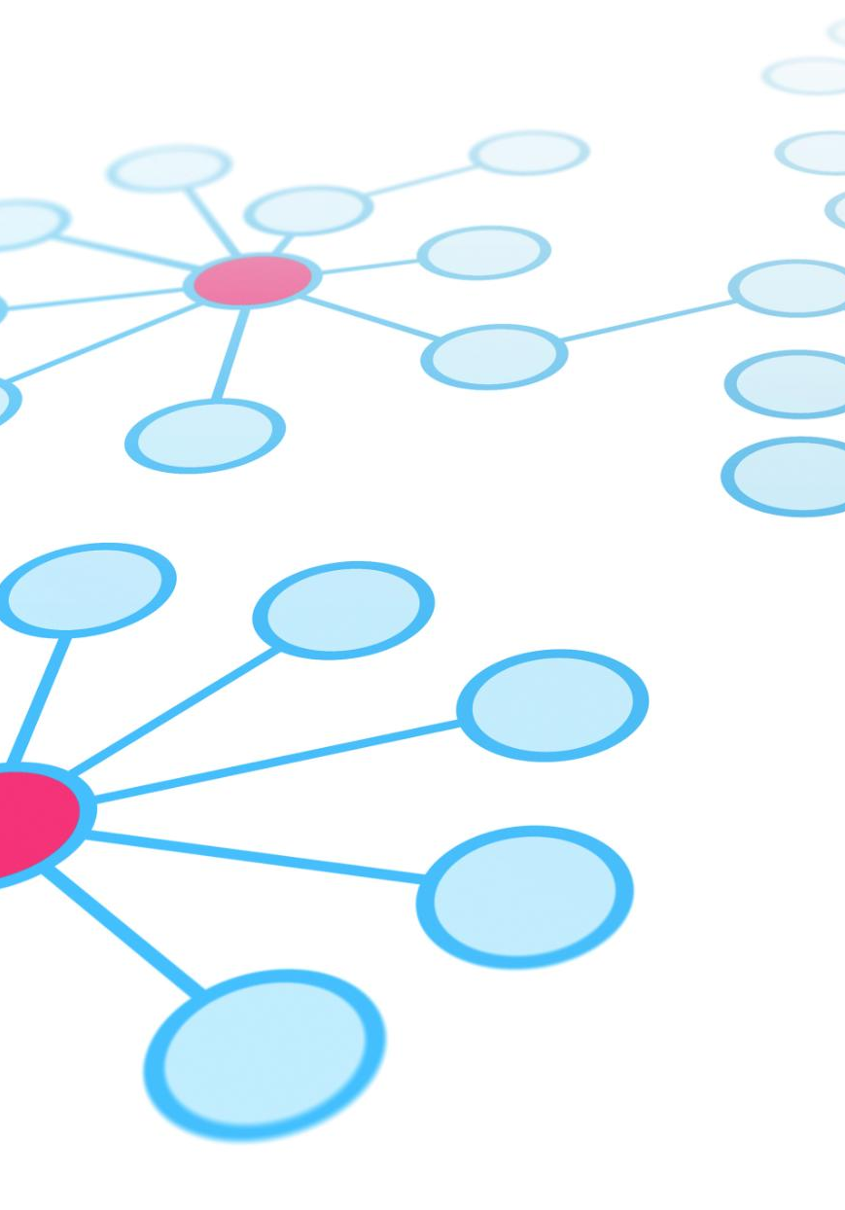
Flexibility and Control in Open Source MLOps
Maximum Flexibility and Customization
Open-source MLOps allows tailored workflows by selecting optimal tools for different machine learning lifecycle stages.
Avoiding Vendor Lock-in
Organizations benefit from avoiding proprietary platforms, gaining independence and control over their MLOps infrastructure.
Integration Challenges and Overhead
Managing diverse tools requires effort in integration and orchestration, increasing operational complexity and resource needs.
Community-Driven Innovation
Open-source MLOps thrives on community contributions, fostering rapid innovation and adaptability.
Notes:
An open-source MLOps stack provides maximum flexibility and control, allowing practitioners to select the best tools for each stage of the machine learning lifecycle. This approach enables customization and avoids vendor lock-in, making it attractive for organizations with specific requirements or those seeking to avoid proprietary ecosystems. However, the open-source route often requires more effort to integrate and manage disparate tools, leading to higher operational overhead. Teams must handle the complexities of connecting orchestration, versioning, experiment tracking, serving, and monitoring components, which can be challenging without dedicated engineering resources. Despite these challenges, open-source MLOps remains popular for its adaptability and community-driven innovation.

Slide 6
Key Tools in the Open Source MLOps Stack
Lifecycle Stage | Open Source Tools
Orchestration | Apache Airflow, Kubeflow Pipelines, Prefect
Versioning | DVC, Pachyderm
Experiment Tracking | MLflow, Weights & Biases (W&B)
Model Serving | Flask, FastAPI, BentoML, Seldon Core, KServe
Monitoring | Evidently AI, NannyML, Prometheus, Grafana
Notes:
The open-source MLOps ecosystem features a variety of specialized tools for each phase of the ML lifecycle. For data and pipeline orchestration, tools like Apache Airflow, Kubeflow Pipelines, and Prefect are widely used to build, schedule, and monitor workflows, managing everything from data ingestion to model training. Data and model versioning is handled by solutions such as DVC (Data Version Control), which integrates with Git for tracking large datasets and models, and Pachyderm, which offers Kubernetes-based data versioning. Experiment tracking platforms like MLflow and Weights & Biases (W&B) help manage experiments, package code, and facilitate collaboration. For model serving, lightweight frameworks like Flask and FastAPI are suitable for simple deployments, while BentoML, Seldon Core, and KServe provide scalable, production-grade serving with features like A/B testing and auto-scaling. Monitoring tools such as Evidently AI, NannyML, Prometheus, and Grafana are essential for tracking model performance and detecting issues like data drift.

Slide 7

Advantages and Challenges of Open Source MLOps
Freedom from Vendor Lock-in
Open-source MLOps allows organizations to avoid vendor lock-in, promoting freedom to customize and innovate rapidly.
Customization and Integration
Highly customizable MLOps stacks can be integrated seamlessly with existing infrastructure and workflows.
Operational Complexity
Increased flexibility leads to higher operational complexity requiring significant integration, maintenance, and updates.
Need for Robust Engineering
Ensuring interoperability and consistent monitoring demands strong engineering practices and ongoing maintenance.
Notes:
The primary advantage of open-source MLOps is the absence of vendor lock-in, granting organizations the freedom to tailor their stack to specific needs and rapidly adopt new innovations. This approach is highly customizable, enabling integration with existing infrastructure and workflows. However, the flexibility comes at the cost of increased operational complexity. Teams must invest significant effort in integrating, maintaining, and updating multiple tools, which can lead to higher overhead and potential reliability issues. Ensuring seamless interoperability and consistent monitoring across the stack requires robust engineering practices and ongoing maintenance.

Slide 8
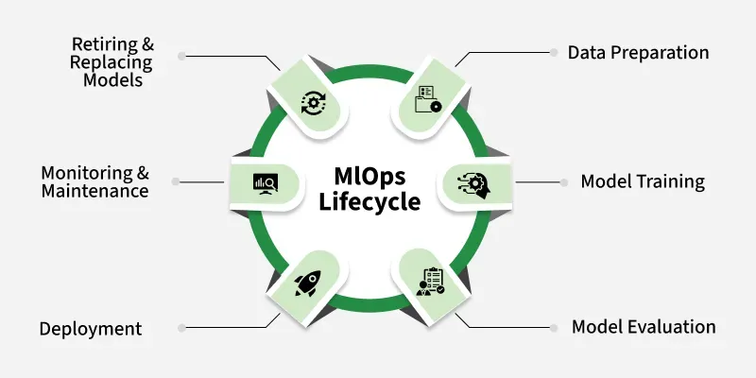
Open Source MLOps Lifecycle
Data Preparation
Data preparation involves collecting, cleaning, and transforming raw data for machine learning models.
Model Training and Validation
Training machine learning models with prepared data and validating them to ensure accuracy and reliability.
Deployment and Monitoring
Deploying models in production environments and continuously monitoring performance and reliability over time.
Notes:
Placeholder: Insert infographic from GeeksforGeeks MLOps Lifecycle page. Recommended source: https://www.geeksforgeeks.org/machine-learning/mlops-components-machine-learning-life-cycle/. This infographic visually summarizes the stages and tools involved in the open-source MLOps lifecycle, from data preparation to monitoring.

Slide 9
MLOps on AWS (Amazon Web Services)
Notes:
AWS MLOps Platform Overview, Core AWS MLOps Components, Integration, Monitoring, and Trade-offs on AWS, Infographic: AWS ML Lifecycle Architecture

Slide 10

AWS MLOps Platform Overview
Comprehensive MLOps Suite
AWS provides an integrated suite of MLOps services covering the full machine learning lifecycle from data to deployment.
Amazon SageMaker Capabilities
SageMaker enables end-to-end machine learning workflows including model training, deployment, and monitoring.
Operational Efficiency
Managed services in AWS MLOps reduce operational burden while accelerating machine learning solution delivery.
Team Collaboration
Deep AWS ecosystem integration facilitates seamless collaboration among data scientists, ML engineers, and DevOps teams.
Notes:
AWS offers a comprehensive and tightly integrated suite of services for MLOps, with Amazon SageMaker as its flagship platform. SageMaker provides end-to-end capabilities for the entire ML lifecycle, including data preparation, model training, deployment, and monitoring. The platform is designed to reduce operational burden by offering managed services and deep integration with the broader AWS ecosystem. This integration enables seamless collaboration between data scientists, ML engineers, and DevOps teams, facilitating the rapid deployment and scaling of machine learning solutions in production environments.

Slide 11
Core AWS MLOps Components
Component | Description
SageMaker Studio | Integrated ML IDE
SageMaker Pipelines | CI/CD for ML workflows
Feature Store | Centralized feature management
Model Registry | Model catalog & versioning
Endpoints | Managed model deployment
Notes:
Amazon SageMaker encompasses several key components that streamline the MLOps workflow. SageMaker Studio serves as an integrated development environment (IDE) for ML, bringing together tools for data exploration, model building, and deployment. SageMaker Pipelines provides CI/CD automation for ML workflows, allowing users to define and manage steps such as data preparation, training, and model registration. The Feature Store centralizes feature management, while the Model Registry catalogs and versions models for production use. SageMaker Endpoints enable fully managed, scalable model deployment with support for auto-scaling and high availability. These components work together to provide a robust, enterprise-grade MLOps solution.

Slide 12
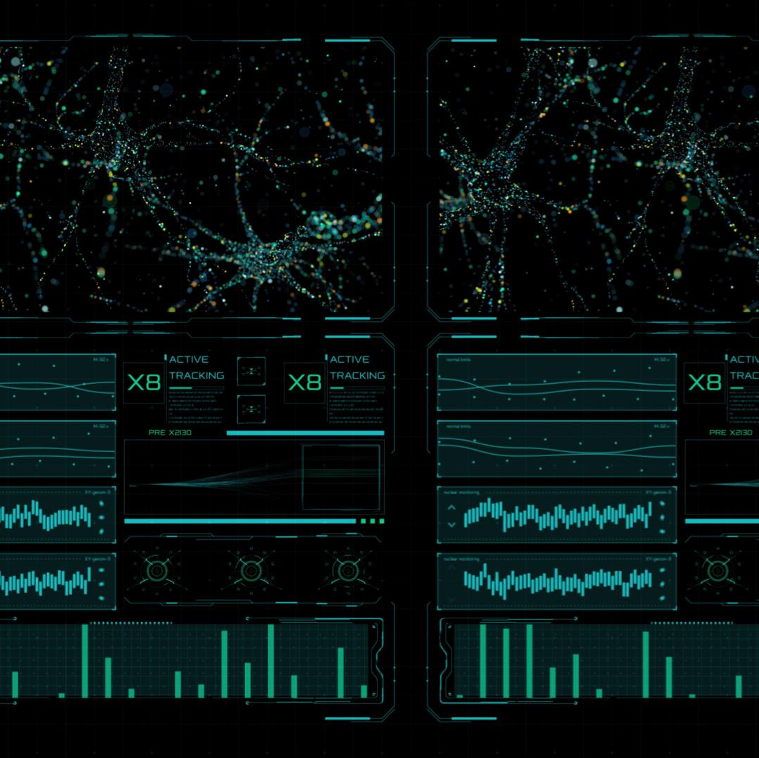
Integration, Monitoring, and Trade-offs on AWS
Native AWS Integration
SageMaker Pipelines seamlessly integrates with AWS DevOps tools for streamlined CI/CD workflows and source control management.
Workflow Orchestration
AWS Step Functions orchestrate complex workflows spanning machine learning and other tasks for efficient automation.
Monitoring and Alerts
Amazon SageMaker Model Monitor detects data drift and integrates with CloudWatch for real-time alerts and logging.
Trade-offs and Considerations
AWS MLOps offers operational simplicity but requires caution around vendor lock-in and cost management.
Notes:
SageMaker Pipelines integrates natively with AWS DevOps tools such as CodeCommit, CodeBuild, and CodePipeline for source control, building, and orchestrating CI/CD workflows. AWS Step Functions can be used to orchestrate complex workflows that span ML and non-ML tasks. For monitoring, Amazon SageMaker Model Monitor automatically detects concept and data drift in deployed models and integrates with Amazon CloudWatch for alerts and logging. The key advantage of AWS MLOps is the deep integration with the AWS ecosystem and the operational simplicity of managed services. However, organizations should be mindful of potential vendor lock-in and the possibility of escalating costs if resources are not managed efficiently.

Slide 13
Infographic: AWS ML Lifecycle Architecture
Data Processing Phase
This phase covers data collection, cleaning, and transformation to prepare data for model training and evaluation.
Model Development
Involves selecting algorithms, training models, and validating performance using the processed data.
Deployment and Monitoring
Models are deployed into production environments with continuous monitoring for performance and issues.
Feedback and Improvement
Feedback loops enable model updates and improvements based on new data and performance insights.
Notes:
Placeholder: Insert infographic from AWS ML lifecycle architecture diagram. Recommended source: https://docs.aws.amazon.com/wellarchitected/latest/machine-learning-lens/ml-lifecycle-architecture-diagram.html. This diagram illustrates the phases of the ML lifecycle on AWS, including data processing, model development, deployment, monitoring, and feedback loops.

Slide 14
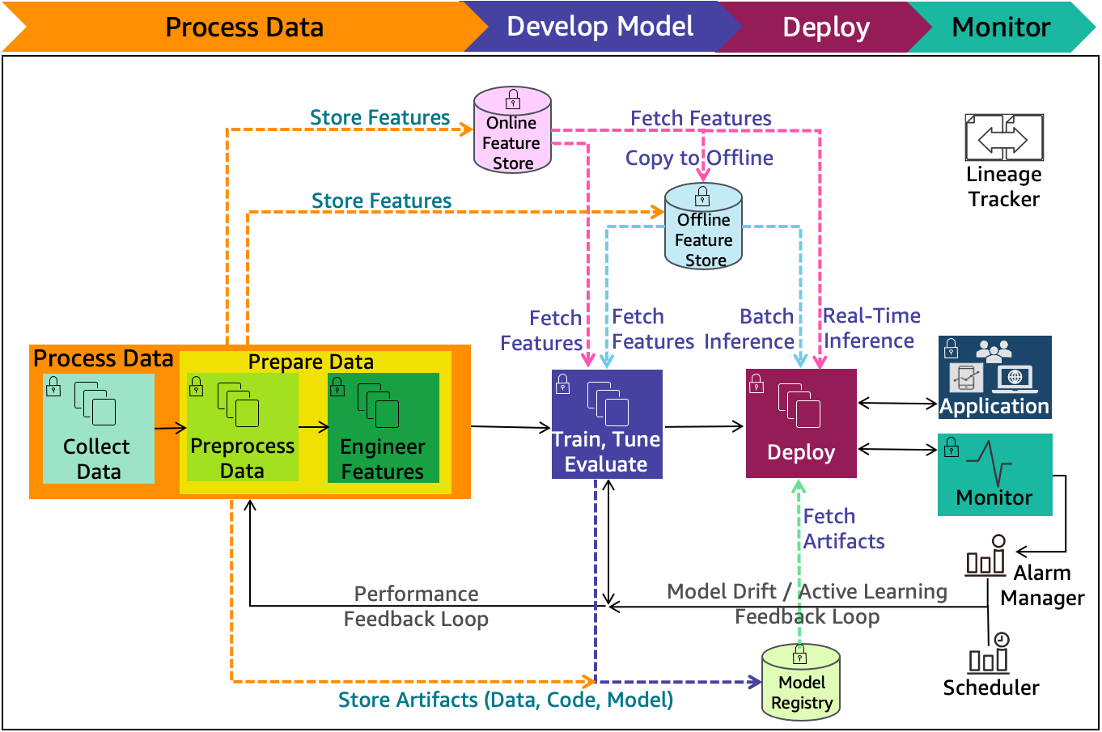
Infographic: AWS ML Lifecycle Architecture
Data Processing Phase
This phase covers data collection, cleaning, and transformation to prepare data for model training and evaluation.
Model Development
Involves selecting algorithms, training models, and validating performance using the processed data.
Deployment and Monitoring
Models are deployed into production environments with continuous monitoring for performance and issues.
Feedback and Improvement
Feedback loops enable model updates and improvements based on new data and performance insights.
Notes:
Placeholder: Insert infographic from AWS ML lifecycle architecture diagram. Recommended source: https://docs.aws.amazon.com/wellarchitected/latest/machine-learning-lens/ml-lifecycle-architecture-diagram.html. This diagram illustrates the phases of the ML lifecycle on AWS, including data processing, model development, deployment, monitoring, and feedback loops.

Slide 15
MLOps on Azure
Notes:
Azure MLOps Platform Overview, Core Azure MLOps Components and Integrations, Advantages and Challenges of Azure MLOps, Infographic: Azure MLOps Lifecycle

Slide 16
Azure MLOps Platform Overview
Centralized ML Workspace
Azure ML Workspace consolidates all machine learning assets and provides tools for seamless management and deployment.
Flexible Workflow Support
Supports Python and YAML workflows, offering flexibility for different user needs and project types.
Responsible AI Features
Built-in tools ensure model interpretability, fairness assessment, and error analysis for ethical AI deployment.
Notes:
Microsoft's MLOps capabilities are centered around Azure Machine Learning (Azure ML), a comprehensive cloud service for building, deploying, and managing ML models. The Azure ML Workspace acts as the central hub, consolidating all ML assets and providing tools for data management, pipeline automation, model registry, and deployment. Azure ML is designed to support both Python-based and YAML-based workflows, offering flexibility for different user preferences and project requirements. The platform emphasizes responsible AI, with built-in tools for model interpretability, fairness assessment, and error analysis.

Slide 17
Core Azure MLOps Components and Integrations
Component | Description
Azure ML Pipelines | Workflow automation
Datasets & Datastores | Data versioning
Model Registry | Model management
Endpoints | Real-time & batch deployment
Responsible AI Dashboard | Interpretability, fairness, error analysis
Notes:
Azure ML Pipelines enable users to create, manage, and automate ML workflows, supporting both real-time and batch scoring through Azure ML Endpoints. The platform provides robust data versioning and management via Datasets and Datastores, while the Model Registry centralizes model registration and versioning. Azure ML integrates seamlessly with Azure DevOps and GitHub Actions for CI/CD automation, allowing for automated retraining and redeployment of models. Monitoring is handled by Azure Monitor, which collects telemetry and detects data drift, ensuring models remain accurate and reliable in production.

Slide 18

Advantages and Challenges of Azure MLOps
Strong Enterprise Integration
Azure MLOps integrates deeply with enterprise tools like Azure DevOps for seamless workflow management and collaboration.
Governance and Compliance Features
The platform emphasizes responsible AI with robust governance, compliance, and transparency features for regulated organizations.
Vendor Lock-in Risk
There is a potential risk of vendor lock-in, requiring strategic planning to avoid dependency on a single cloud provider.
Complexity for New Users
The extensive feature set can overwhelm new users, necessitating careful resource management and training.
Notes:
Azure MLOps stands out for its strong integration with enterprise tools like Azure DevOps and its focus on responsible AI. The platform offers a wide array of features for governance, compliance, and transparency, making it suitable for organizations with stringent regulatory requirements. However, similar to AWS, there is a risk of vendor lock-in, and the extensive range of options can be overwhelming for new users. Careful planning and resource management are necessary to fully leverage Azure's capabilities while controlling complexity.

Slide 19
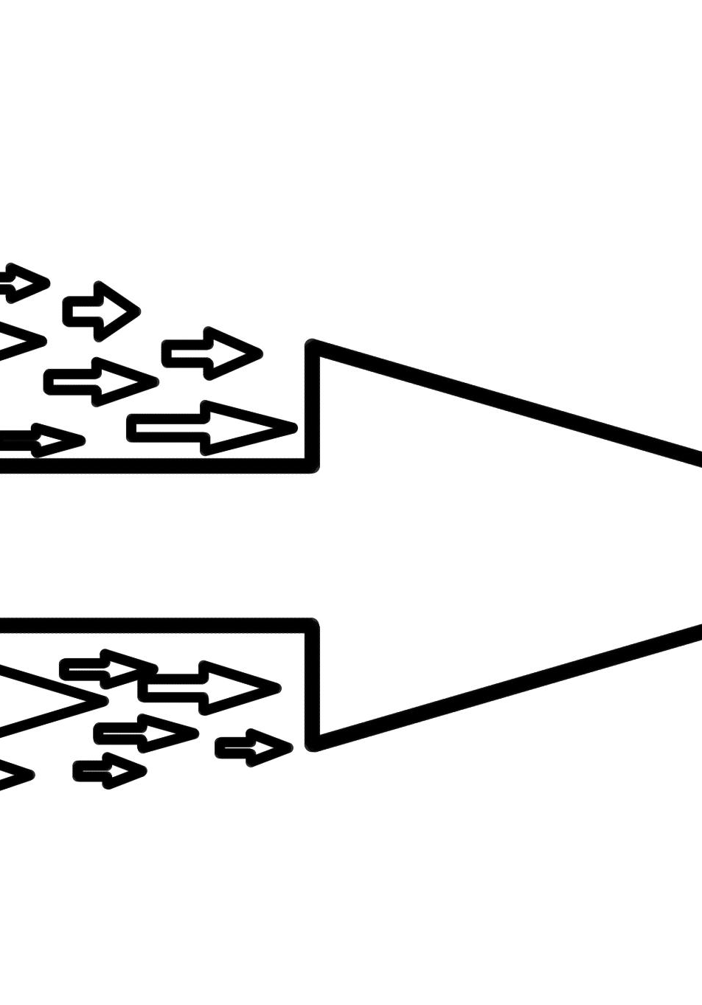
Infographic: Azure MLOps Lifecycle
Deployment Process
Azure MLOps streamlines machine learning models deployment with scalable and efficient pipelines.
Monitoring Systems
Continuous monitoring ensures model performance and reliability in production environments.
Automation Capabilities
Automation reduces manual efforts by orchestrating training, testing, and deployment workflows.
Responsible AI Features
Azure MLOps incorporates responsible AI principles promoting fairness, transparency, and compliance.
Notes:
Placeholder: Insert infographic from Microsoft Azure MLOps page. Recommended source: https://azure-int.microsoft.com/en-us/products/machine-learning/mlops/. This infographic provides a visual overview of the Azure MLOps lifecycle, including deployment, monitoring, automation, and responsible AI features.

Slide 20
Summary and Platform Comparison
Notes:
Comparing Open Source, AWS, and Azure MLOps

Slide 21

Comparing Open Source, AWS, and Azure MLOps
Open Source Flexibility
Open-source MLOps provides maximum customization but needs significant integration and operational effort.
AWS Managed Tools
AWS offers integrated MLOps tools reducing operational burden but may cause vendor lock-in and higher costs.
Azure Enterprise Focus
Azure emphasizes responsible AI and DevOps integration but can be complex to implement for enterprises.
Choosing the Right Platform
Organizations should select MLOps platforms based on customization needs, resources, and existing tool integration.
Notes:
Open-source MLOps offers maximum flexibility and customization but requires significant integration and operational effort. AWS provides a managed, integrated suite of MLOps tools that reduce operational burden but may lead to vendor lock-in and higher costs. Azure delivers enterprise-ready MLOps with a focus on responsible AI and deep integration with DevOps tools, but its complexity can be daunting. Organizations should choose their MLOps platform based on their need for customization, available operational resources, and the degree of integration required with existing tools and workflows.

